Slide 1
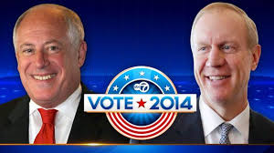
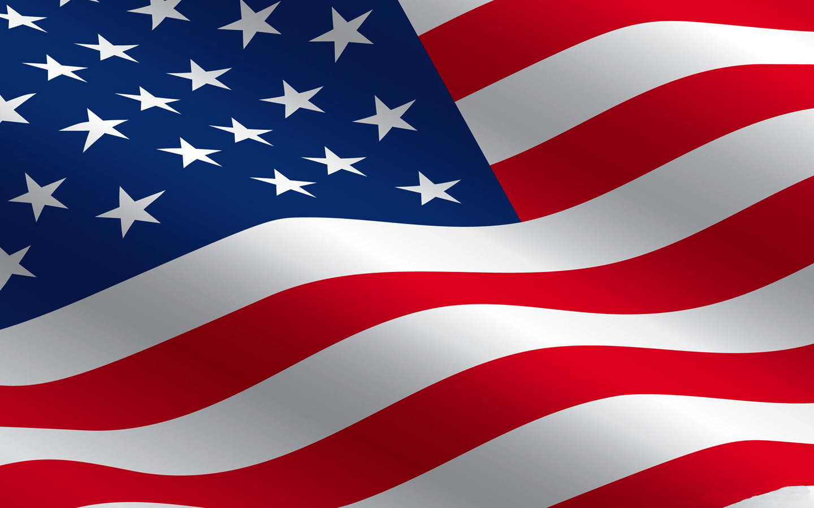



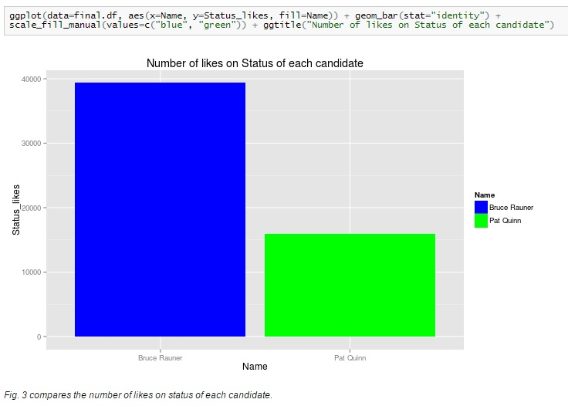
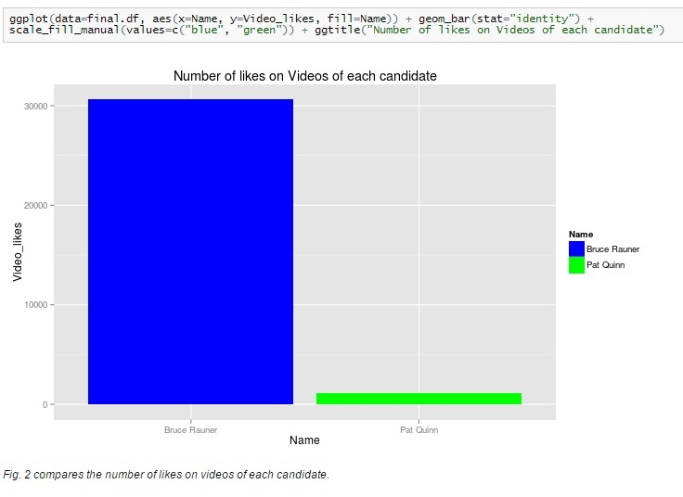

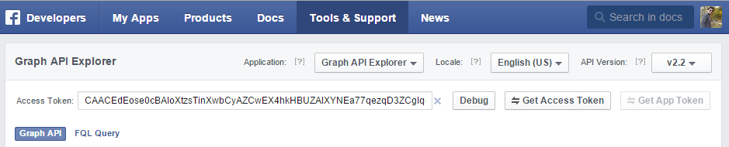
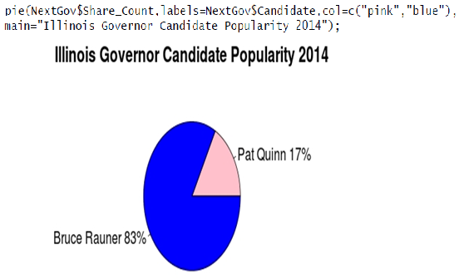


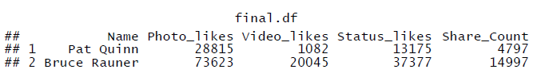
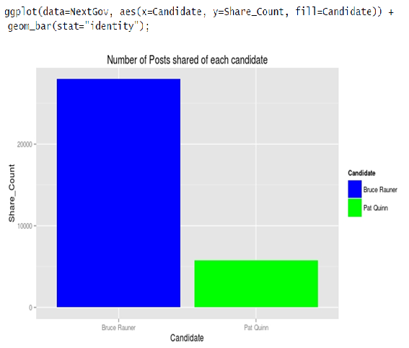
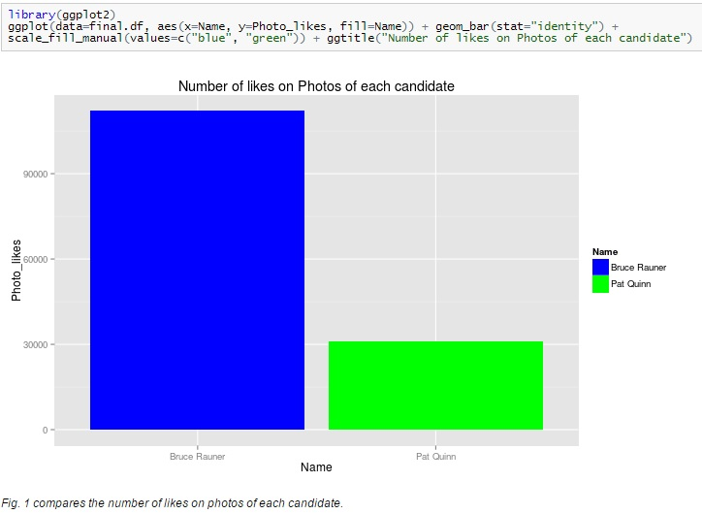
Can predict Illinois Governor’s race?
Nikunj Ratnaparkhi & Shweta Vyas
School of Information Technology, Illinois State University
Mentor: Dr. James Wolf
Abstract
Procedure
  “status” provides the list of status in this column
  “video” provides the list of video in this column
Step-6: Some Mathematics
Sum command is used to add the values in the shares_count column of the data frame which gives the total number of times Bruce Rauner’s and Pat Quinn’s posts are shared by their followers in the year 2014.
Lastly, sum photo, video and status likes for Pat Quinn:
And, sum photo, video and status likes for Bruce Rauner:
Step-7: Final Data frame:
After collecting the data about the number of likes on status, photos and videos and shares count of each candidate, a data frame to store the final results(numbers) is created.
And the final data frame will look like:
In the era of web based networking, social media websites like Facebook and Twitter are influencing the lives of people across the globe. In recent times, social media has become an influential part of every political campaign. Savvy politicians are using social media to reach voters and communicate with campaign staffers. Social media also allows voters to be more actively engaged in political elections. Facebook, Twitter and other social media allow voters to hear directly from the candidates and to share their opinions about candidates and issues. Many have suggested that social media may be useful for predicting election results.
The most recent Illinois gubernatorial elections, held on November 4, 2014, pitted Democratic candidate Pat Quinn against Republican candidate Bruce Rauner. The purpose of this research is to analyze whether Facebook can be used to make predictions about the Illinois Governor’s Race. This research also explores the use the statistical programming language R to extract data from the Facebook profiles of users - by extracting the number of likes on photos, videos, and status - to make general predictions about their popularity.
Step-1: Import the libraries:
Step-2: Create the temporary token
  Go to Graph API at www.developers.facebook.com/tools/explorer/ and click on Get Access Token button to generate the token.
  A temporary token valid for 2 hours is generated.
Step-3: GetPage – Rfacebook Package
Use the function “getPage” with the parameters ‘BruceRauner’ or ‘GovernorQuinn’ (Facebook page name for the candidates) along with the token and maximum number of rows.
Step-4: Clean Data To get 2014 records only
Now data obtained is cleaned in such a way that records from current year, “2014” are taken into consideration - as the candidates start their campaigning since the beginning of this year.
To achieve this, date format is changed using format command to DD-MM-YYYY. The format is a command in base package through which the date format is changed from standard %Y%M%D format to any desired format.
Search the pattern “2014” in the created time column through grep command.
Step-5: Get Likes on Photos, Videos and Status
The column “type” of data frame has information about type of post like photo, video, status etc.
grep command on type column with
  “photo” provides the list of photos in this column
As seen through the graphs, number of shared posts, likes on photos, videos and status of Bruce Rauner is much more than that of Pat Quinn.
Popularity of Pat Quinn Vs Bruce Rauner:
Usually result of elections are given based on the percentage of people who voted and then percentage of votes received by each candidate.
So when we calculate the percentage of shares in year 2014, Bruce Rauner shows higher percentage than incumbent Governor Pat Quinn.
Using the pie command(present in the base package) a pie chart is created.
Purpose
The purpose of this paper is to understand and analyze how Facebook can be used to make predictions about Illinois Governor’s Race. In recent times Social media has become quite influential in bringing to light all the political happenings in any part of the world. Politicians these days put all their campaign details and spend huge amount of money in IT to increase the likes, shares and followers count.
Social media is not only beneficial to the candidates but also to the voters who can closely follow the activities and views of each candidate and even share their opinion - thereby making a sensible decision of who deserves their vote in the upcoming election.
Using language R, this report predicts the result of election for the Illinois Governor’s position by fetching the data from Facebook using Rfacebook package. Through this research paper we have extracted data from candidates’ Facebook profile - number of likes on photos, videos, status, and number of shared posts - and made predictions about their popularity.
Conclusion
Social media is quite beneficial in predicting and analyzing elections these days. Other factors which might influence this analysis might be people who vote in the elections do not follow candidate on Social media, changing trends in followership of several social media sites, illegally increase of likes and share, etc.
On December 17, 2014, Illinois State election results were announced and our prediction held true. Bruce Rauner managed to push out the incumbent Democratic Governor, Pat Quinn in a close and nasty manner.
By knowing the number of likes on photos, videos and status, and number of shared posts, can help us in connecting the dots between a candidate’s popularity and his/her chance of winning the election.
Graphs
Import Library:
With ggplot command create a bar graph which shows the count of posts shared for both the candidates:
References:
http://elections.nytimes.com/2014/illinois-elections
http://ballotpedia.org/Bruce_Rauner
http://ballotpedia.org/Pat_Quinn_(Former_governor_of_Illinois)

